Slide 1
RNA-Seq Pre-processing
Lauren Vanderlinden
BIOS 6660
Spring 2019

Slide 2
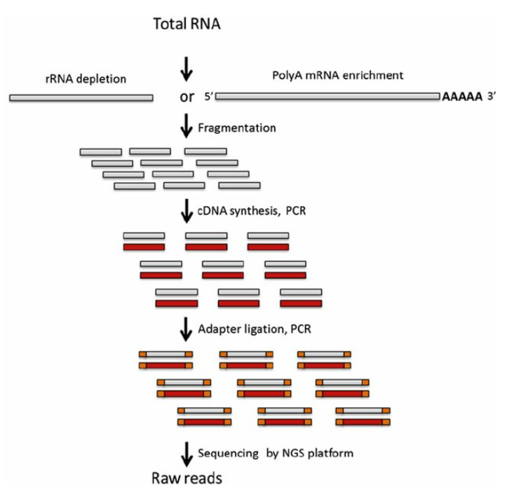
Overview from Last Time
Talked about RNA-Sequencing
Importance of RNA expression
Technology used to get sequences
Now you have raw reads!
source: RNAseqlopedia

Slide 3
Pre-processing Pipeline
Raw Reads
Trim Reads
Optional: Transcriptome Reconstruction
Quantitate
Genome Alignment

Slide 4
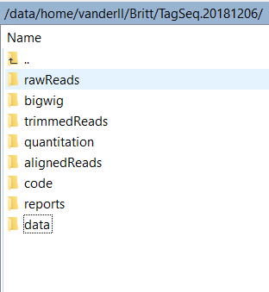
Folder Structure
For a typical coverage where the main goal is differential expression (25-30 million reads/sample) raw files range around 2-3.8 GB
Find it useful to have these files in separate folders for each part of the process:
rawReads
trimmedReads
alignedReads
quantitation
data (matrix form finally)
Suggestion only

Slide 5
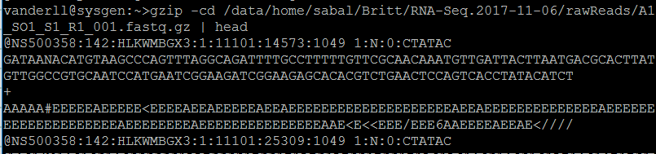
FASTQ Format
Raw Reads
Notice I’m using the pipping Pam talked about
ID
Sequence
Quality
Single-end technology will give you 1 fastq file/sample
Paired end technology will give you 2 fastq files/sample
4 lines for each read
Unique Read ID: begins with '@' character and is followed by a sequence identifier and an optional description (like a FASTA title line).
Raw sequence letters
Begins with a '+' character and is optionally followed by the same sequence identifier (and any description) again.
Encodes the quality values for the sequence in Line 2, and must contain the same number of symbols as letters in the sequence.

Slide 6
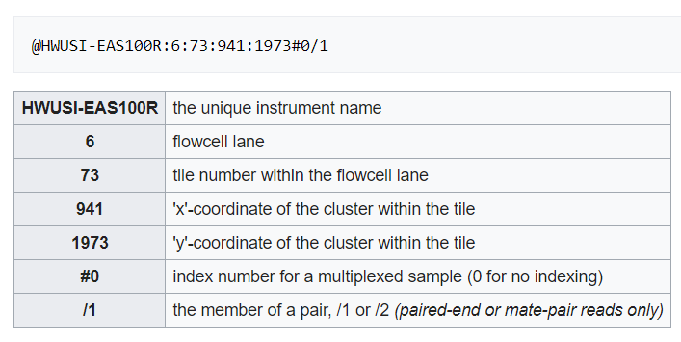
FASTQ Illumina ID Format
Source: wikipedia

Slide 7
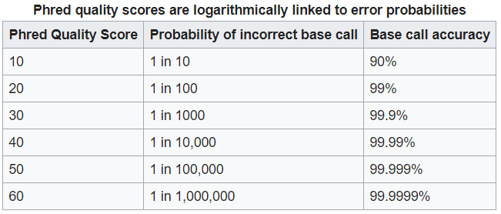
Phred Quality (Q) Score
A score assigned to each individual base called
Developed to help in the automation of DNA sequencing in the Human Genome Project
Phred score is logarithmically related to the base-calling error probabilities
Illumina standards say Phred of 30 or higher considered “high quality”
Source: wikipedia

Slide 8
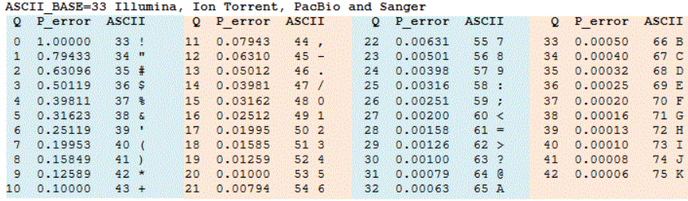
FASTQ and Phred Quality Score
FASTQ score represented as ASCII-33 characters
Quality
Source: USEARCH

Slide 9
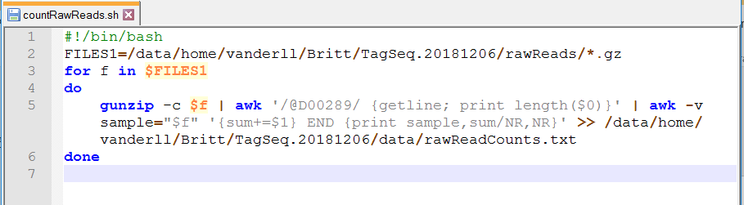
How many reads do I have?
One of the first questions before anything else is how many reads do my samples have?
Make a bash script to count the number of reads you have
Notice I’m counting the number of lines which start with @D00289, not the total lines in the file
Writes a text file with your fastq name and number of reads

Slide 10
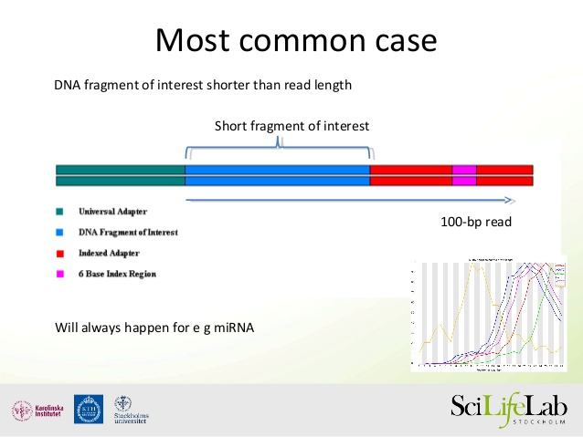
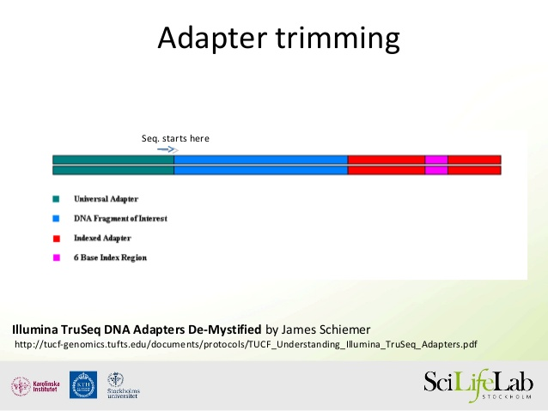
Trim Reads
Trim Reads
Adapter Trimming
Trimming off the adapter sequences of reads
ABSOLUTE MUST for small RNA
Improves de novo assemblies
Quality Trimming
May increase mapping rates
May also loose information
Software Programs
BBDuk
Cutadapt
Trim Galore!
PRINSEQ
Trimmomatic
Sickle/Sythe
FASTX Toolkit
Universal Adapter
DNA Of Interest
Indexed Adapter
6 base Index
Source: SciLifeLab

Slide 11
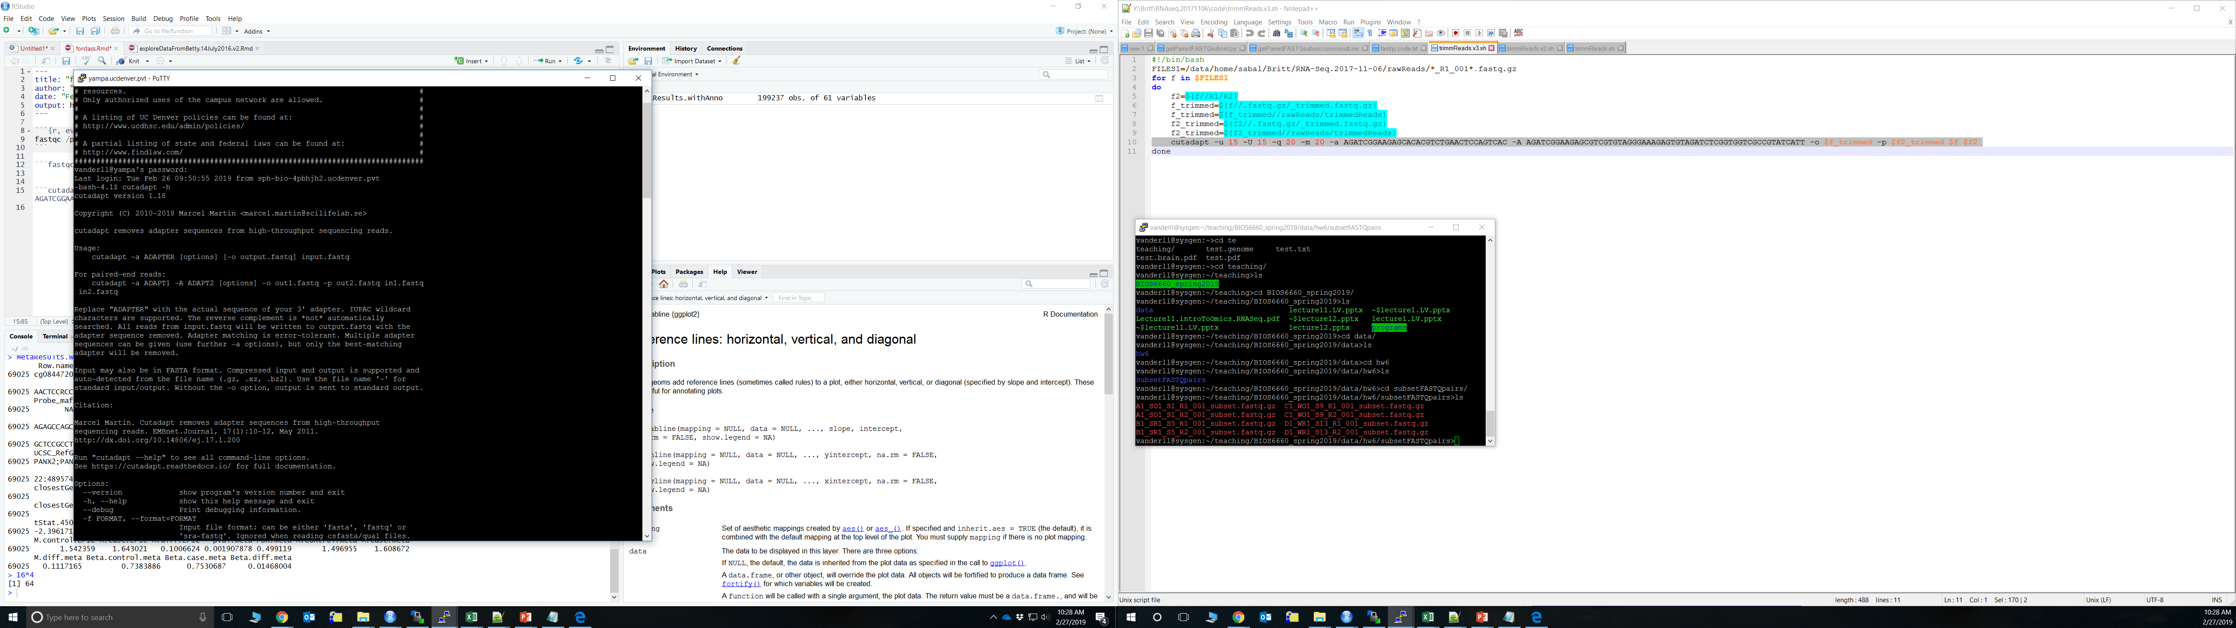
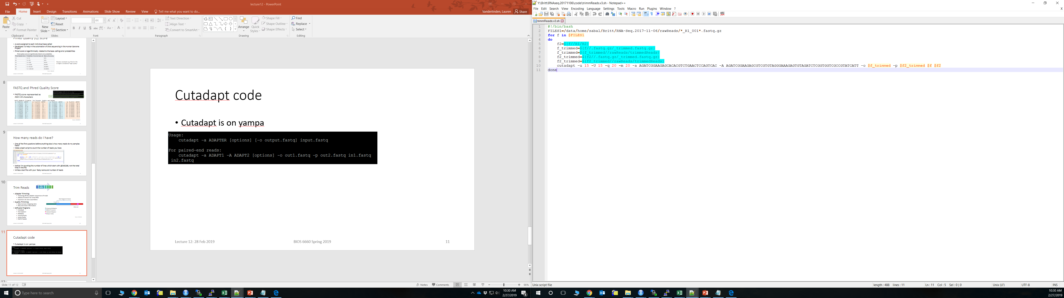
Cutadapt code
Extra options I’ve used:
-q quality score cut-off before adapter removal
-m minimum length if read to keep after trimming
-u remove a specified length of bases from beginning
Cutadapt is on yampa
Example bash script

Slide 12
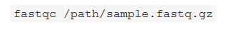
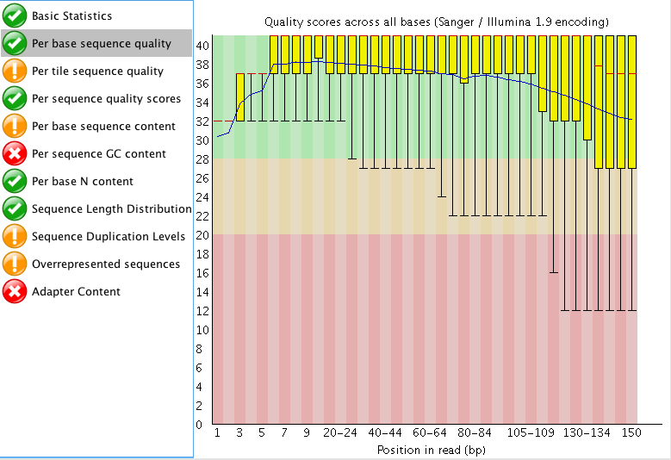
FastQC
Quality Score Across Bases
FastQC installed on yampa
Program which evaluates quality of reads
Use this to check the trimming went well
Want to stay in the green zone
Really want green checks on:
Per sequence quality scores
Per base sequence content
Look at example report

Slide 13
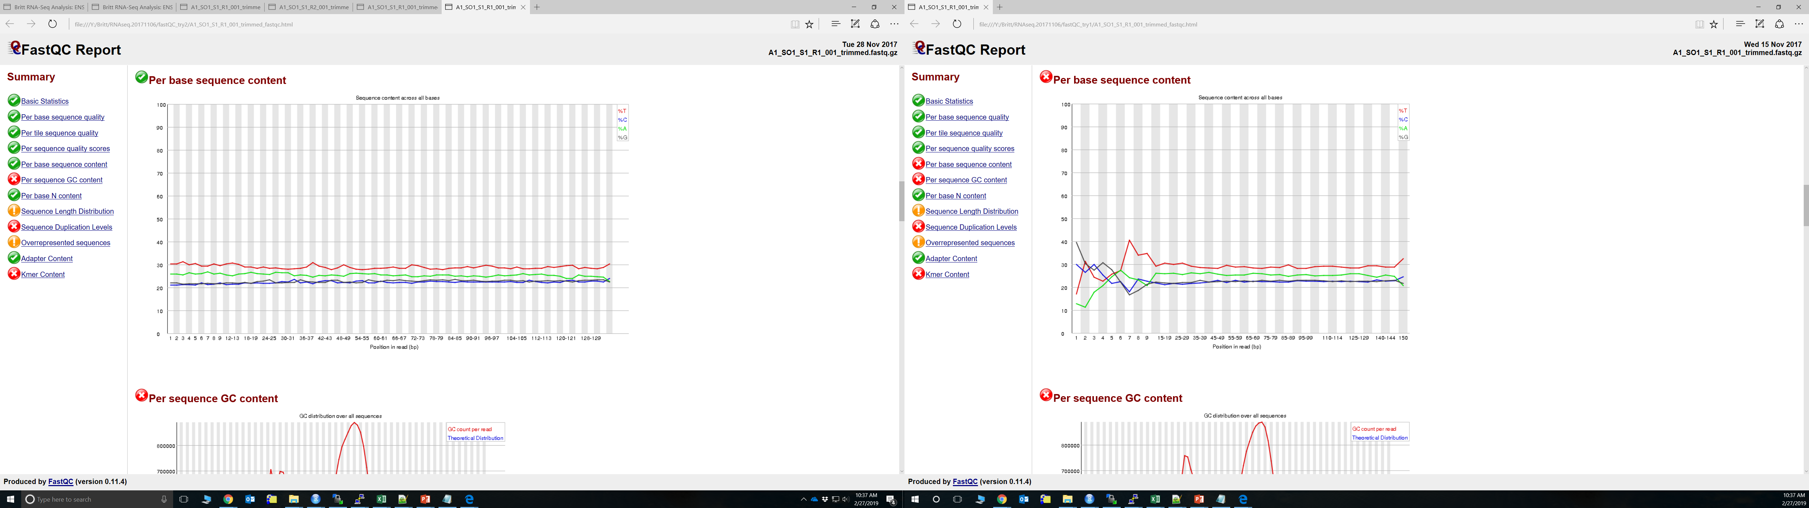
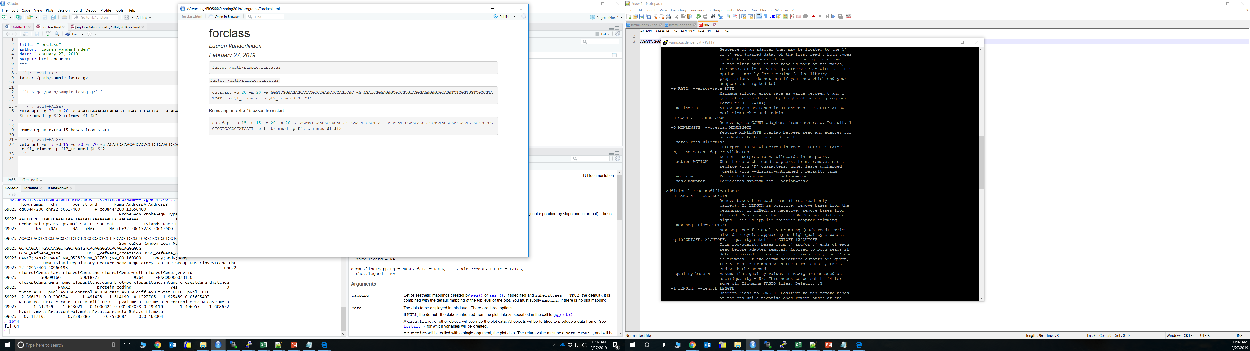
FastQC Pre and Post Quality Trimming
Bias in sequence composition is often seen in 1st 12-15 bp in Illumina
(Hansen et al, 2010)

Slide 14
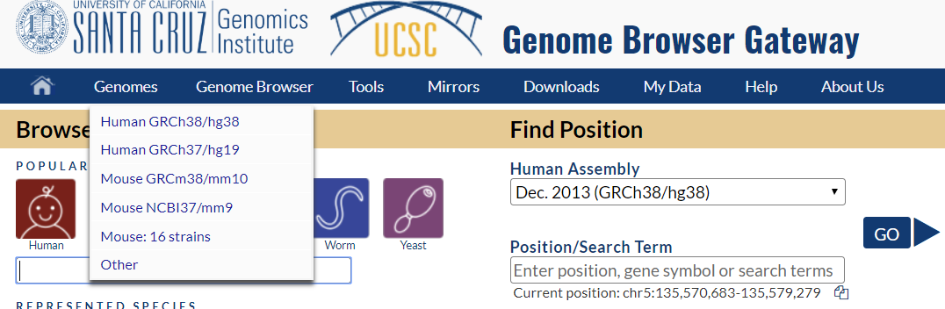
Align Reads to Genome
Genome Alignment
Align reads to a reference genome
Humans: Genome Reference Consortium human genome build 38 (GRCh38, aka hg38)
hg19 is still commonly used
Species | Most recent reference genome
Fruit fly | dm6
Mouse | mm10
Rat | rn6
Human | hg38

Slide 15
Alignment Tools
Unspliced Aligners (No Gaps Allowed)
BWA
Bowtie/Bowtie2
NovoAlign, SeqMap, SEAL
Spliced Aligners (Allows Splice-Junctions)
Erange
SpliceSeq
BBMap
Hisat/Hisat2
STAR
TopHat
Annotated Guided Aligners
De Novo Splice Aligners

Slide 16
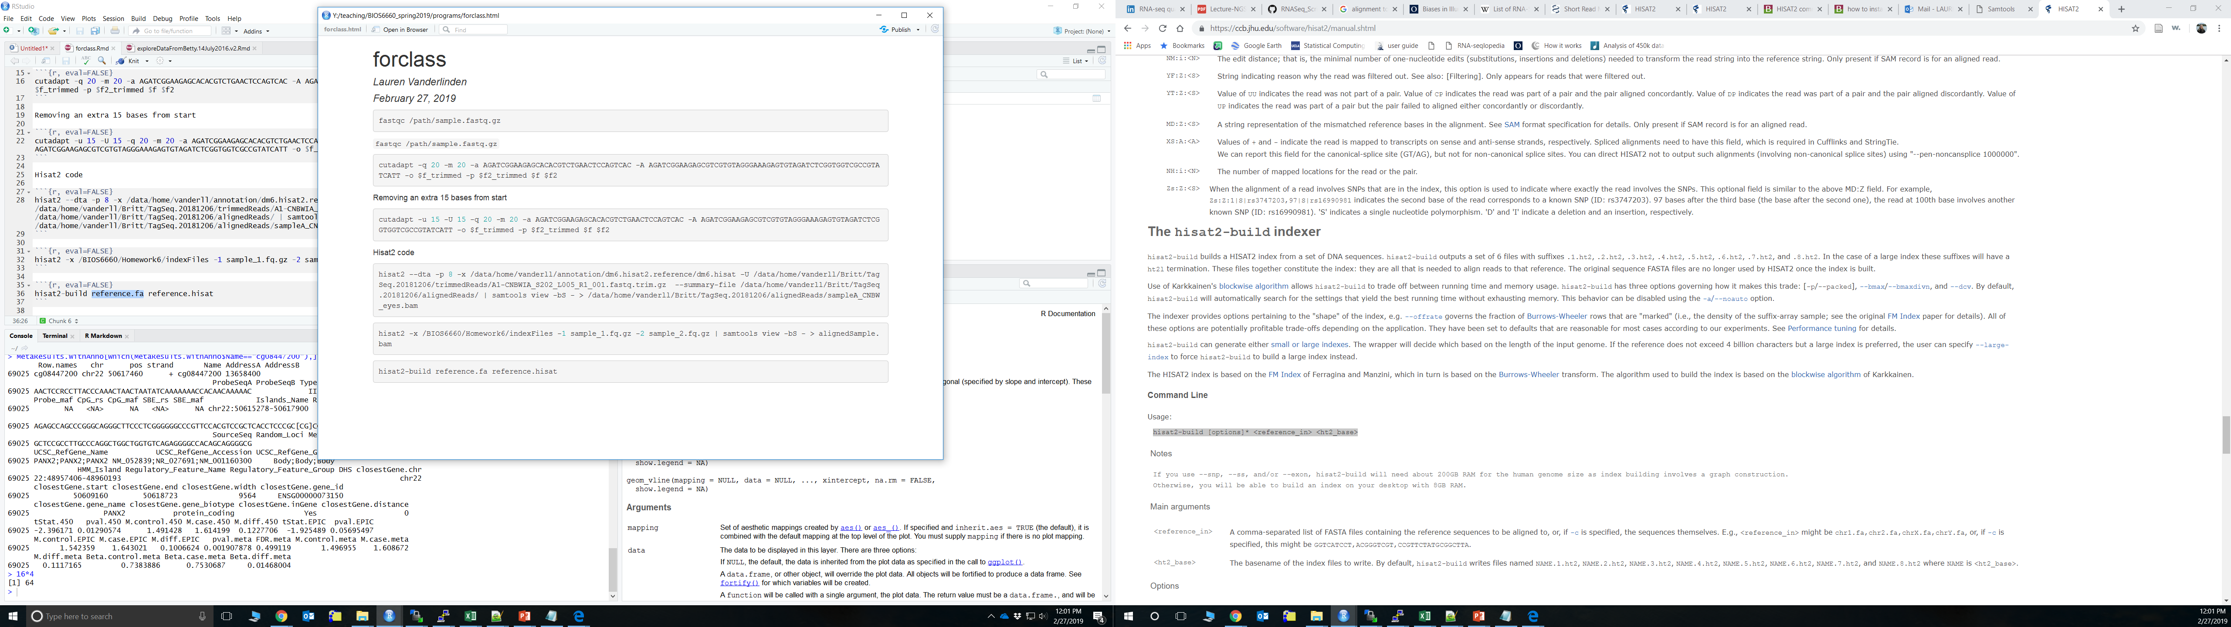
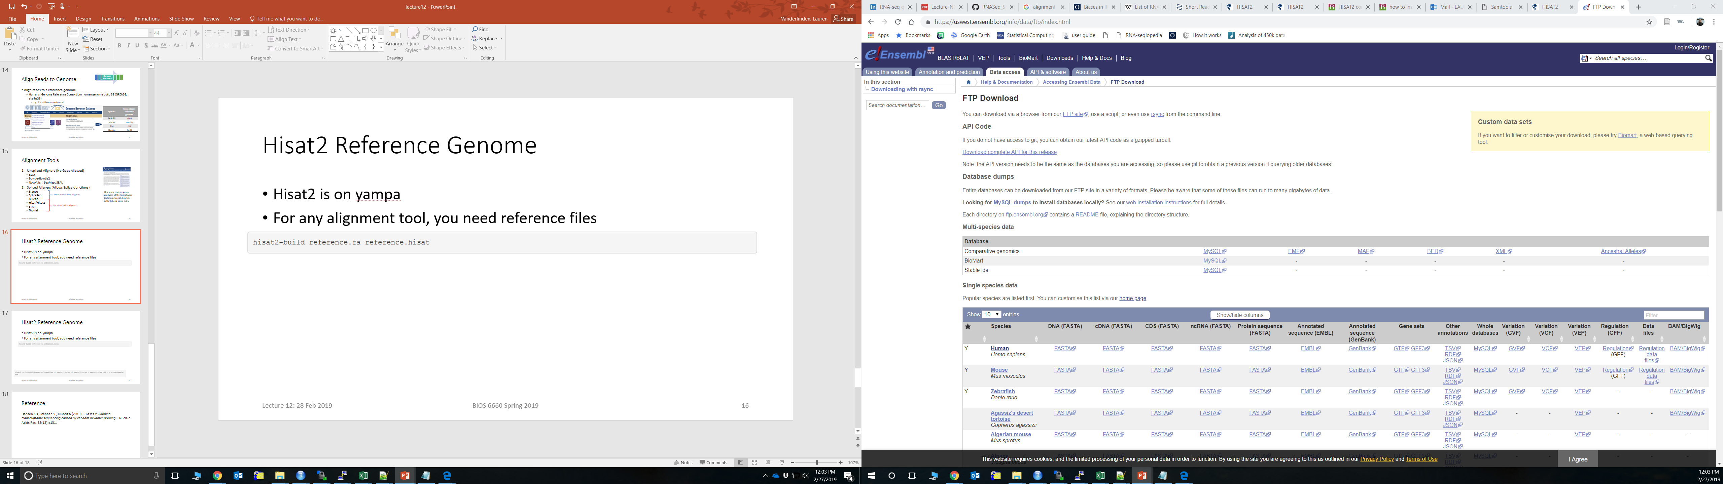
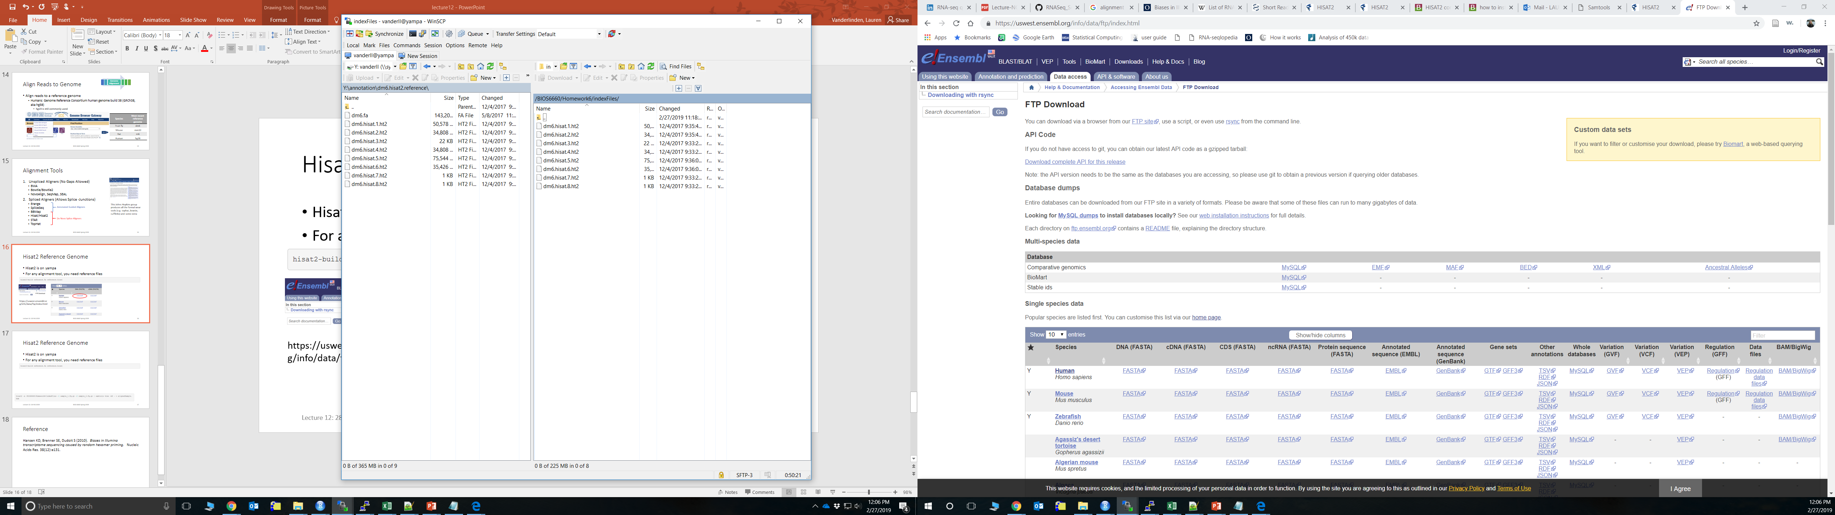
Hisat2 Reference Genome
Hisat2 is on yampa
For any alignment tool, you need reference files
https://uswest.ensembl.org/info/data/ftp/index.html

Slide 17
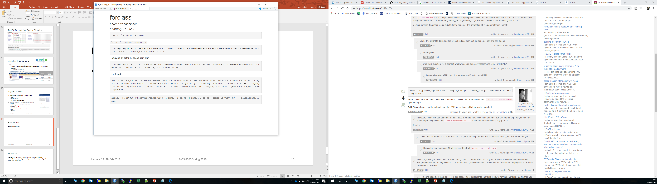
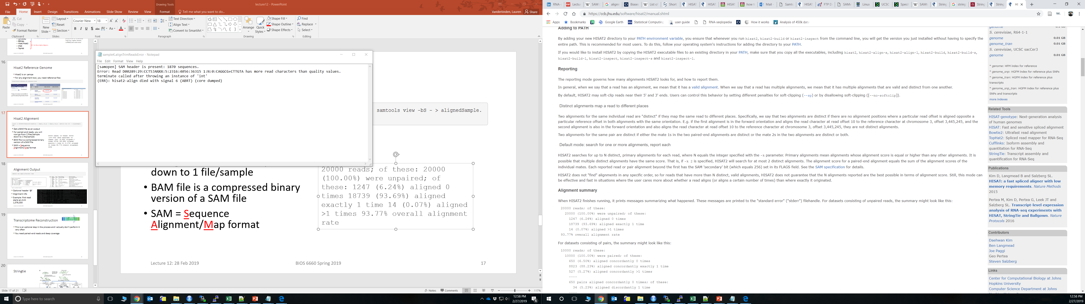
Hisat2 Alignment
Options you might want:
--un writing an output file for those that don’t align
-N # mismatches you will allow (default 0)
For paired-end reads, you will now go from 2 files/sample down to 1 file/sample
BAM output file is a compressed binary version of a SAM file
SAM = Sequence Alignment/Map format
Message it prints after running:

Slide 18
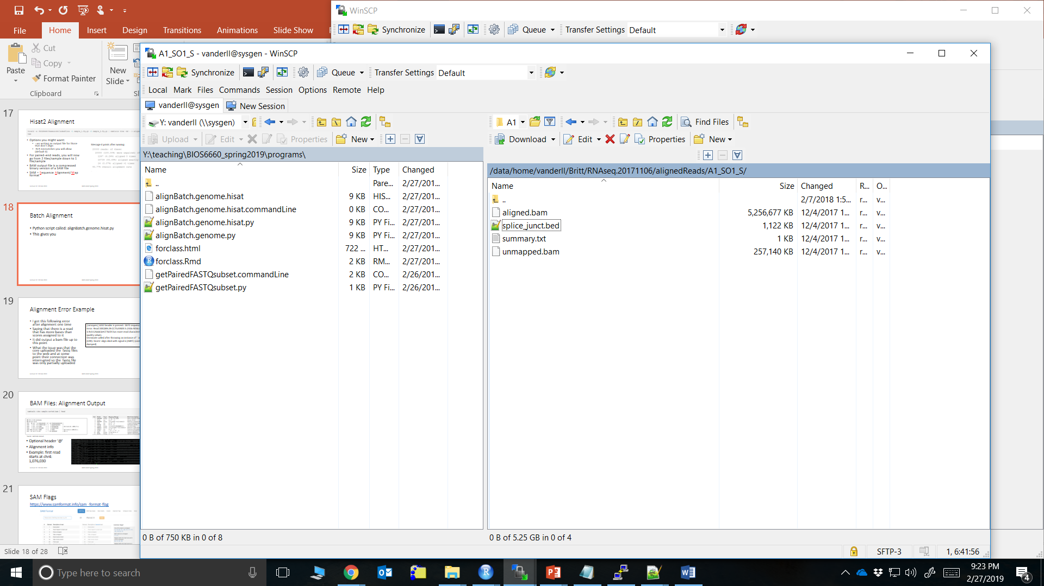
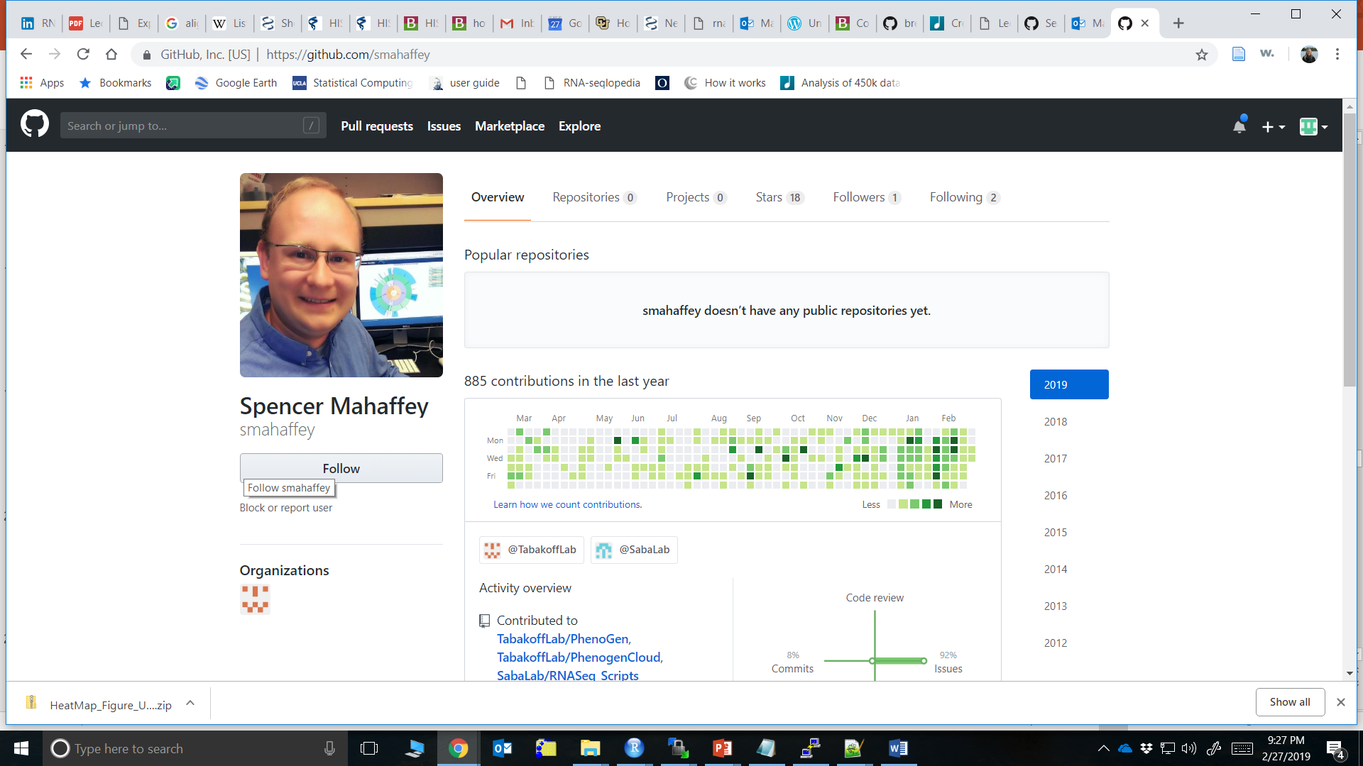
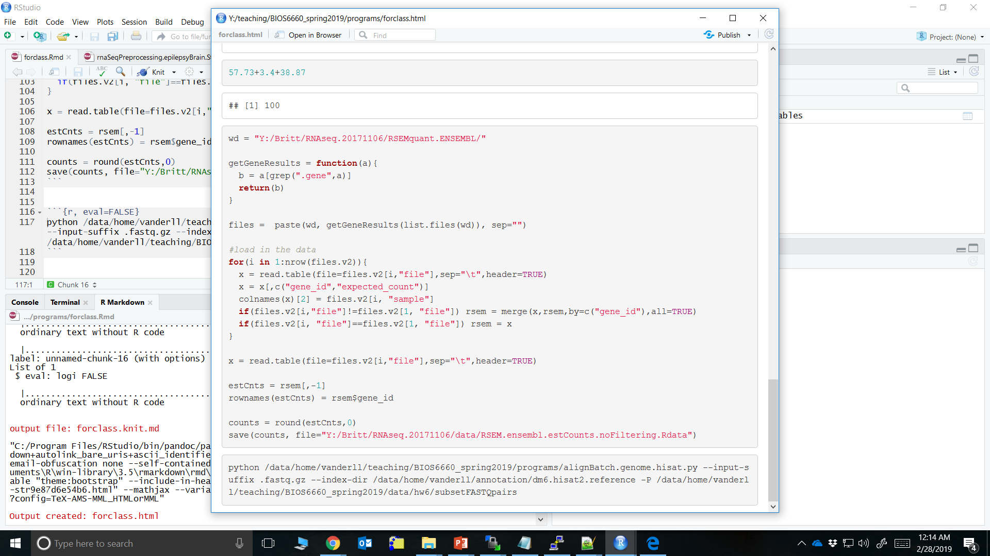
Batch Alignment
Python script called: alignBatch.genome.hisat.py
Written by Spencer Mahaffey (thank you!)
This gives you 4 files:
Aligned.bam
Splice_junct.bed
Summary.txt
Unmapped.bam
Look at py script

Slide 19
Alignment Error Example
I got this following error after alignment one time
Saying that there is a read that has more bases than scores assigned to it
It did output a bam file up to this point
What the issue was that the core uploaded the fastq files to the web and at some point their connection was interrupted so the fastq file was only partially uploaded
[samopen] SAM header is present: 1870 sequences.
Error: Read D00289:29:CCT5JANXX:5:2316:4056:36315 1:N:0:CAGGCG+CTTGTA has more read characters than quality values.
terminate called after throwing an instance of 'int'
(ERR): hisat2-align died with signal 6 (ABRT) (core dumped)

Slide 20
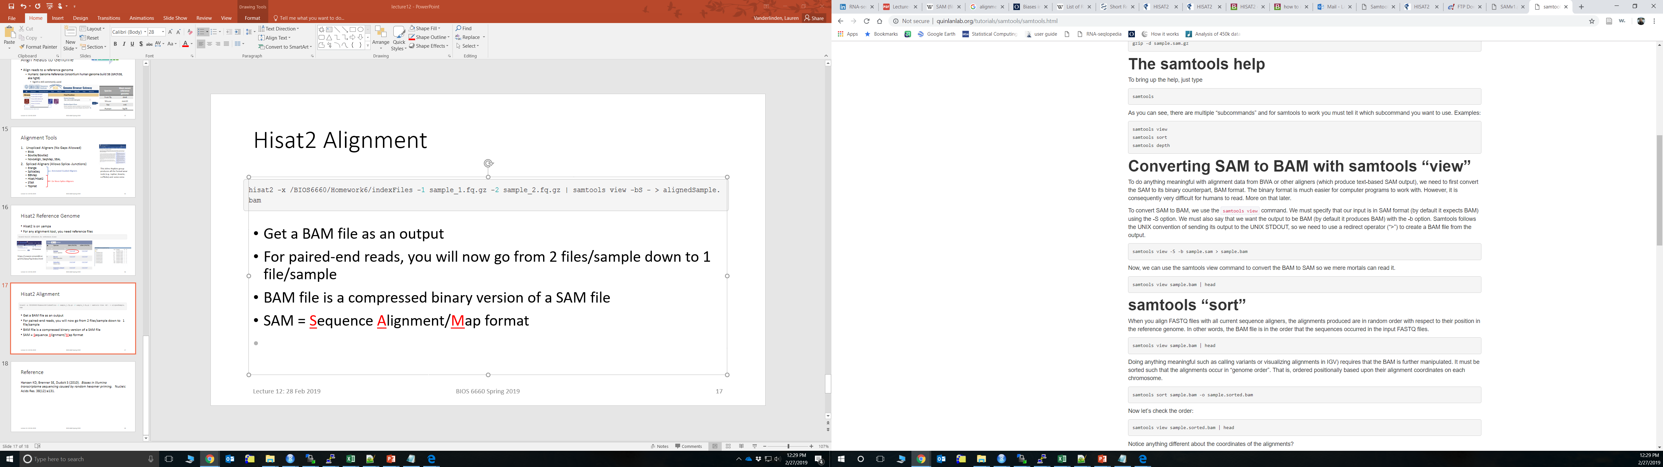
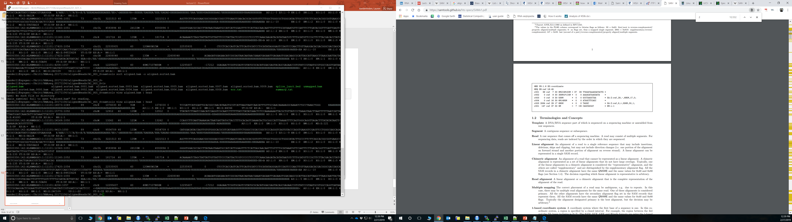
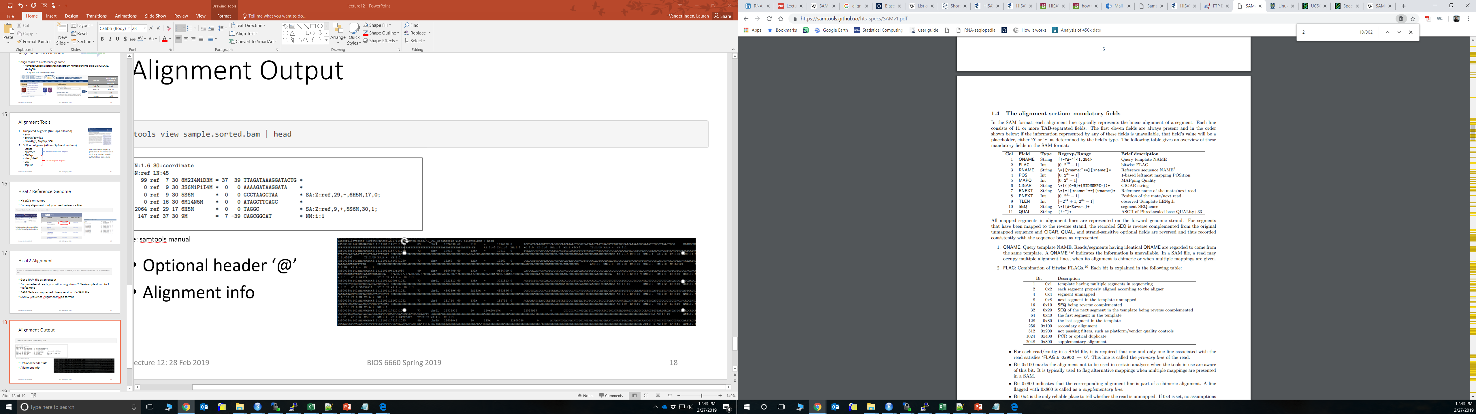

BAM Files: Alignment Output
Source: samtools manual
Optional header ‘@’
Alignment info
Example: first read starts at chr4: 1,076,030

Slide 21
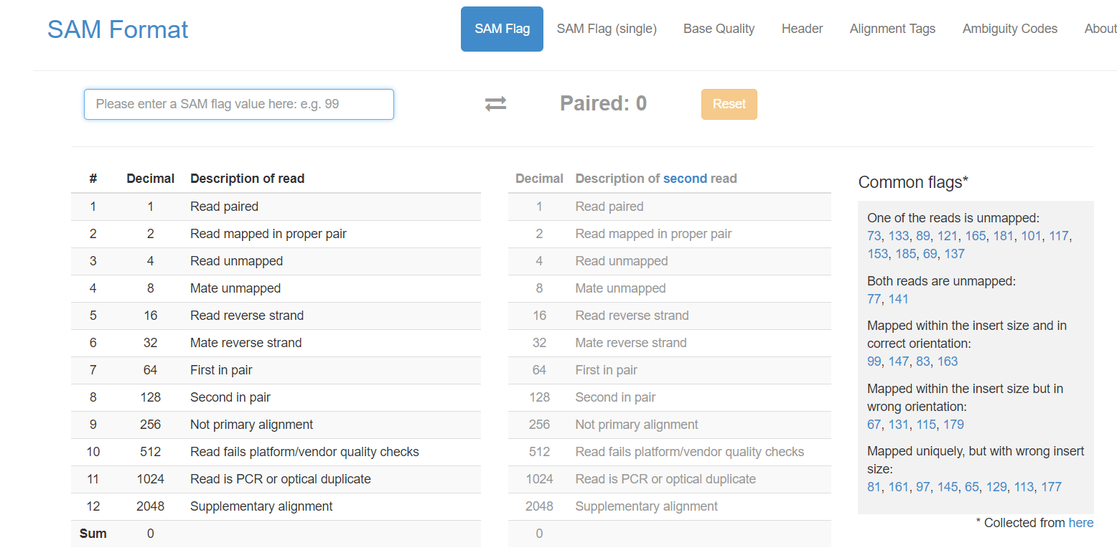
SAM Flags
https://www.samformat.info/sam-format-flag

Slide 22
Transcriptome Reconstruction
Optional: Transcriptome Reconstruction
This is an optional step in the process and I actually don’t perform it very often
You need paired-end reads and deep coverage
Software:
Cufflinks
Stringtie
Scripture
Traph
Trinity
TransAbyss
Velvet
Reference guided assemblies
De novo assemblies

Slide 23
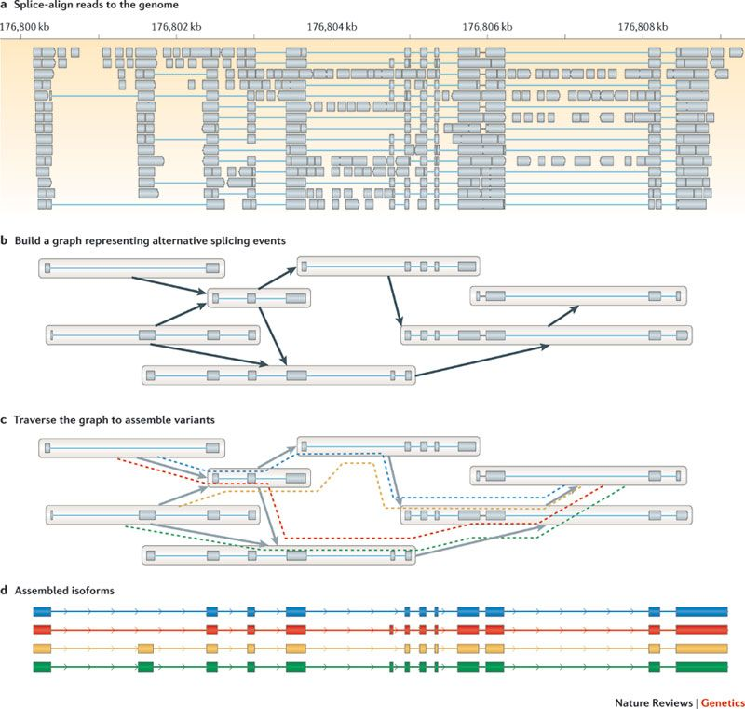
Reference Guided Assemblies
Splice junctions are the main guiding force in the reconstruction
See which exons of these splice junctions overlap
Estimate your isoforms
Source: Martin & Wang 2015

Slide 24
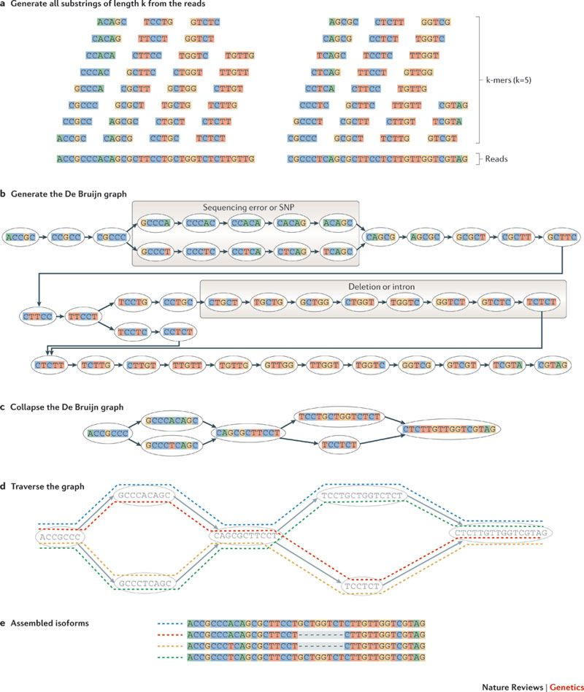
De Novo Assemblies
Depends on De Brujin graph
Combinatorial mathematics, creates every possible combinations of length k
Identify indels and SNPs/errors
Estimate your isoforms
Computationally much more time than reference based approach
Source: Martin & Wang 2015

Slide 25
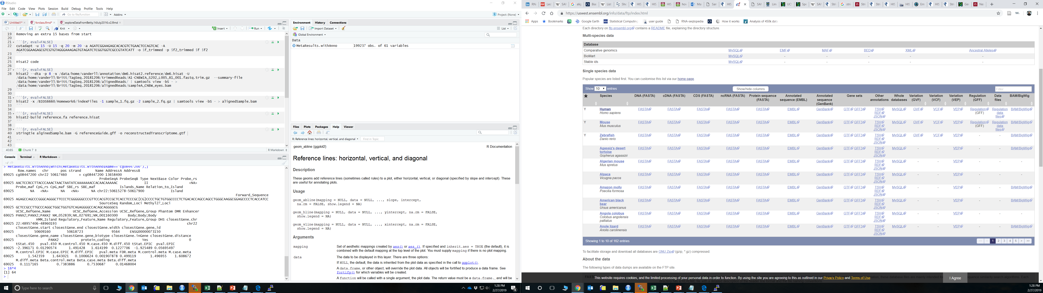
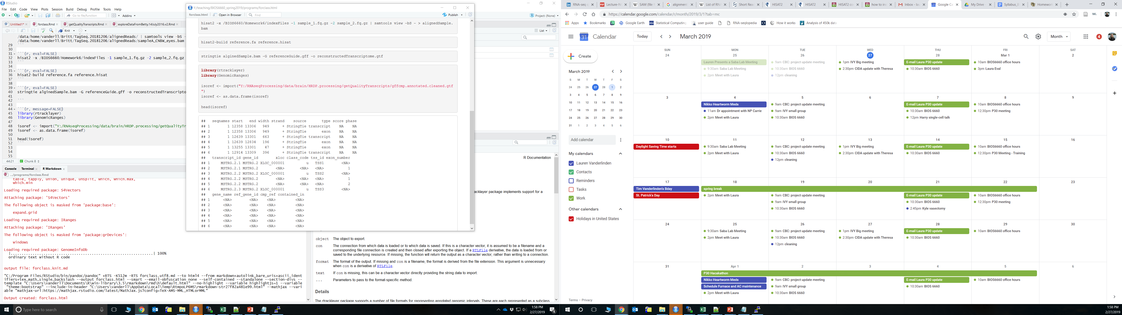
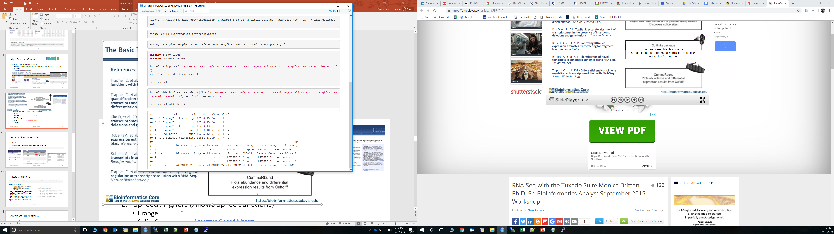
Gene Transfer Format (GTF)
Transcriptome file format
Can get references from ENSEMBL: Gene sets
Easy to look at using R/rtracklayer

Slide 26
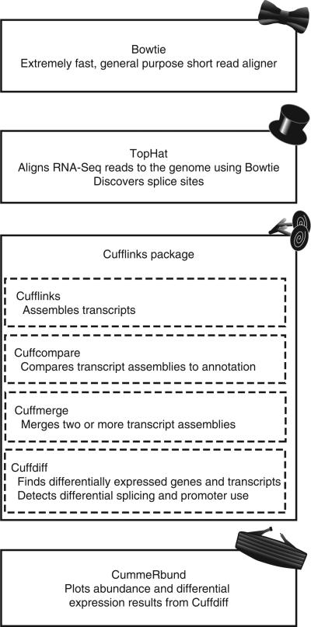
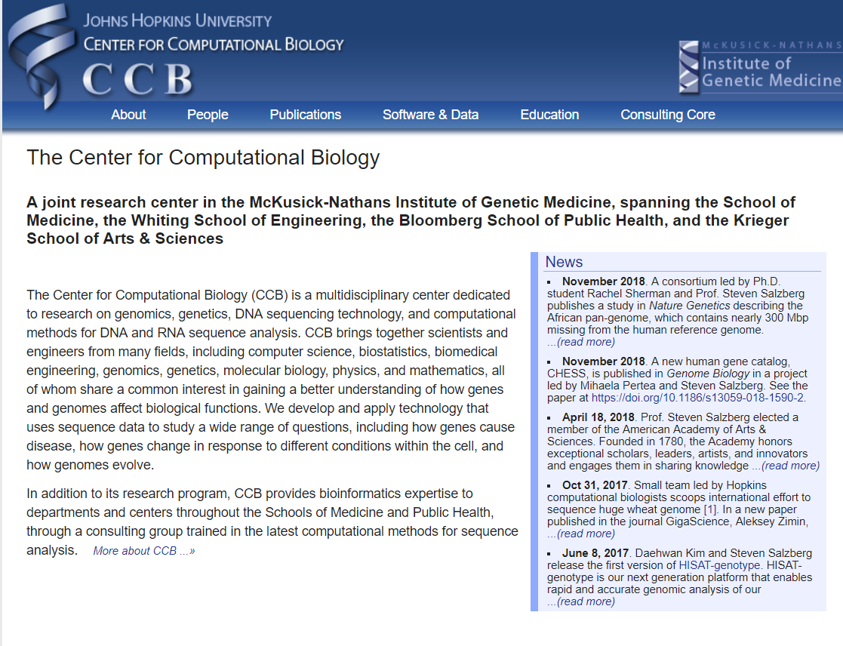
Tuxedo Suite
New version of tophat is hisat2
Newer version of cufflinks is stringtie
This Johns Hopkins group produces all the “Tuxedo Tools”
This suite is extremely popular
Source: Trapnell et al, 2012

Slide 27
Quantitate Reads
Quantitate
Summarize on either the gene level or isoform level
HTSeq (python module) or RSEM
HTSeq not good for overlapping reads (i.e. not good for isoforms)
Reads
Isoform 1
Isofrom2

Slide 28
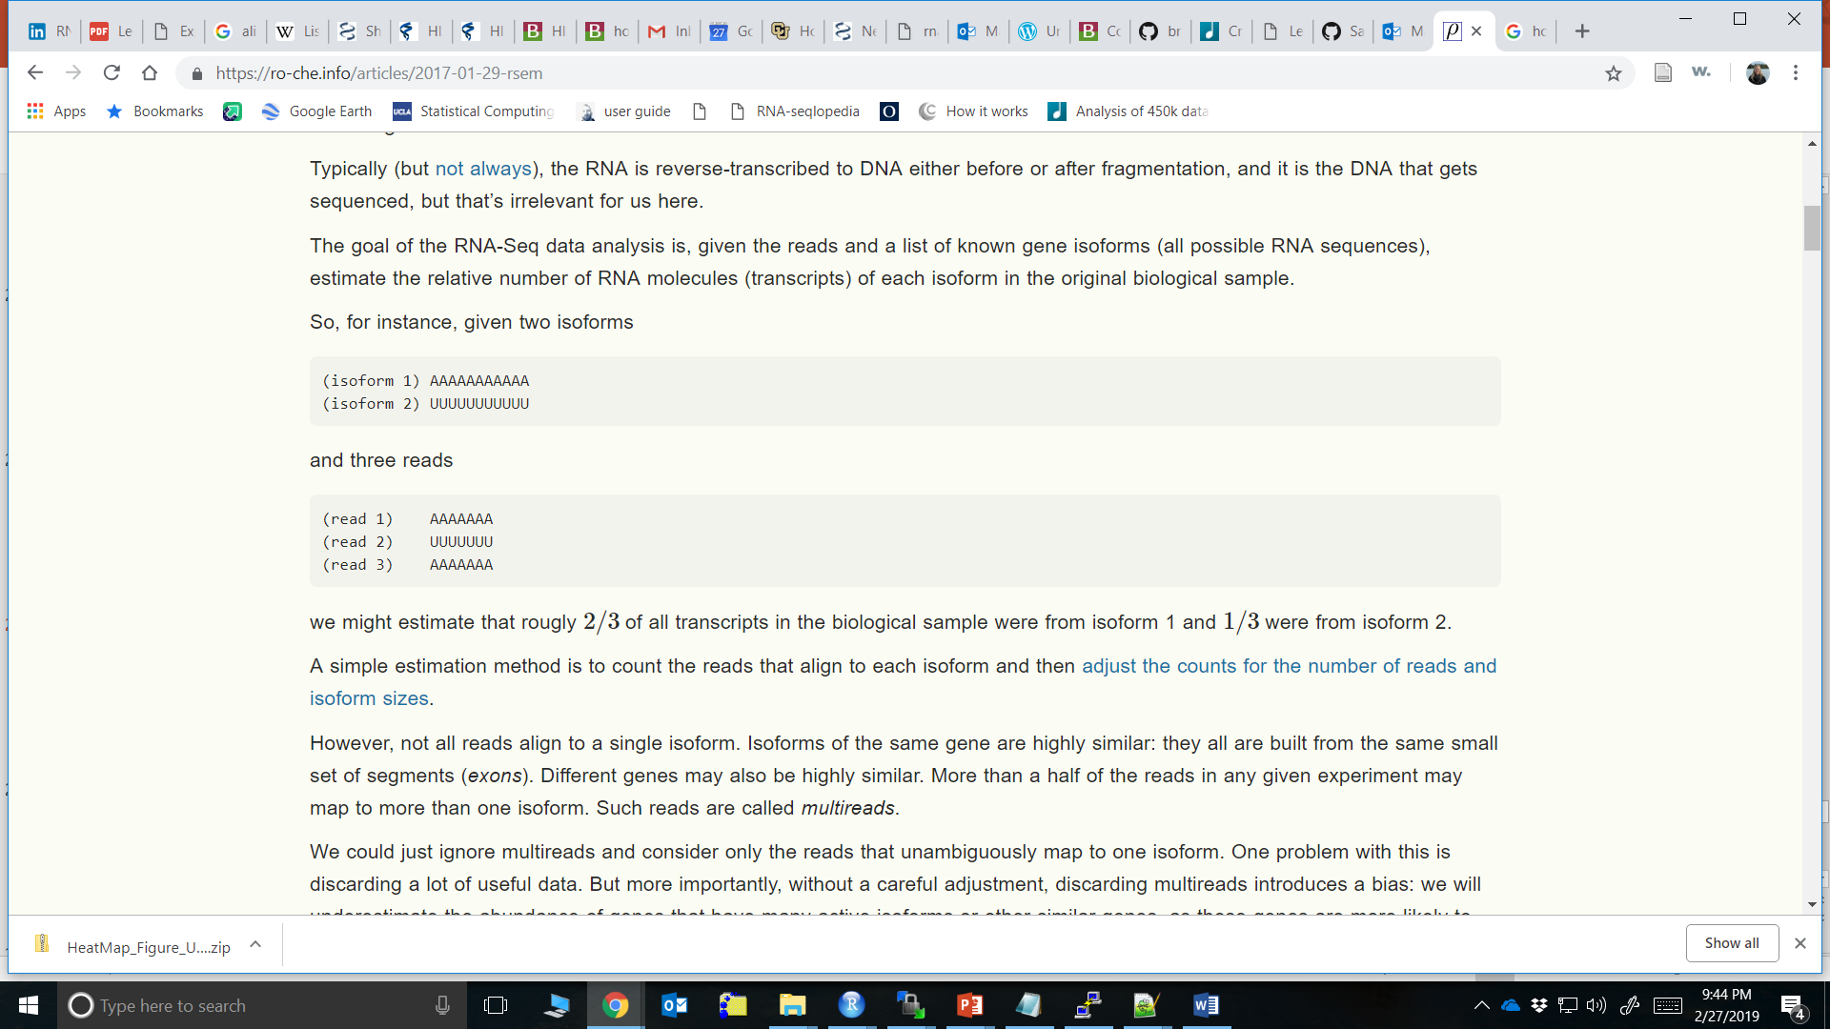
RSEM Quantitation
RNA-Seq Expectation Maximization (RSEM). Li et al, 2010
Say you have a gene with 2 isoforms. Each has it’s own unique exon
Say you have 3 reads for these
Would say 2/3 of your reads for this gene come from isoform 1

Slide 29
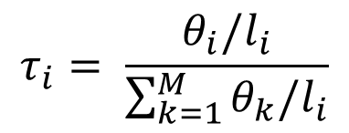
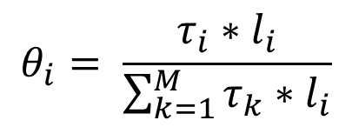
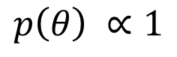
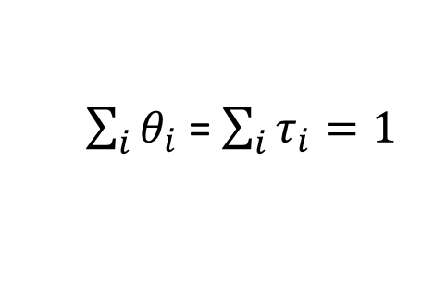
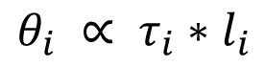
RSEM Quantitation 2
$$θ_{i}= \frac{τ_{i}∗l_{i}}{\sum_{k=1}^{M}{τ_{k}∗l_{i}}}$$
However, example was extremely simplified as isoforms are highly similar and many don’t have completely unique exons.
Isoform 1: Exon1-Exon2-Exon3-Exon4
Isoform 2: Exon1-Exon3-Exon4
Isoform 3: Exon2-Exon3-Exon4
Notation
N = total # of reads (library size)
M = # known isoforms
L = read length
Li = length isoform
τi = TPM (fraction of transcripts belong to isoform i out of all transcripts in sample * million)
ϴi = prior probability any single read derived from isoform i
Take away θ has a constant (uniform) probability density
$$τ_{i}= \frac{θ_{i}/l_{i}}{\sum_{k=1}^{M}{θ_{k}/l_{i}}}$$
$θ_{i} ∝ τ_{i}∗l_{i}$
$\sum_{i}{θ_{i} }$= $\sum_{i}{τ_{i}=1 }$
$$p\left(θ\right) ∝1$$

Slide 30
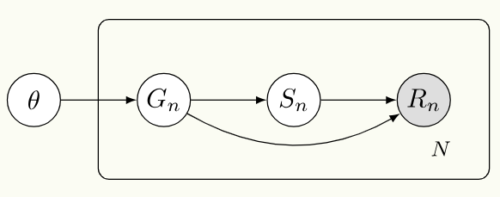
RSEM Quantitation 3
What does an estimate of ϴ (or τ) look like?
Full posterior distribution is p(ϴ|R) or p(τ|R)
Li et al 2010, describe following Bayesian network (a probabilistic graphical model):
Gn is isoform and Sn is starting position
Probability of a read coming from a specific gene with influence the number of reads you see in your data

Slide 31
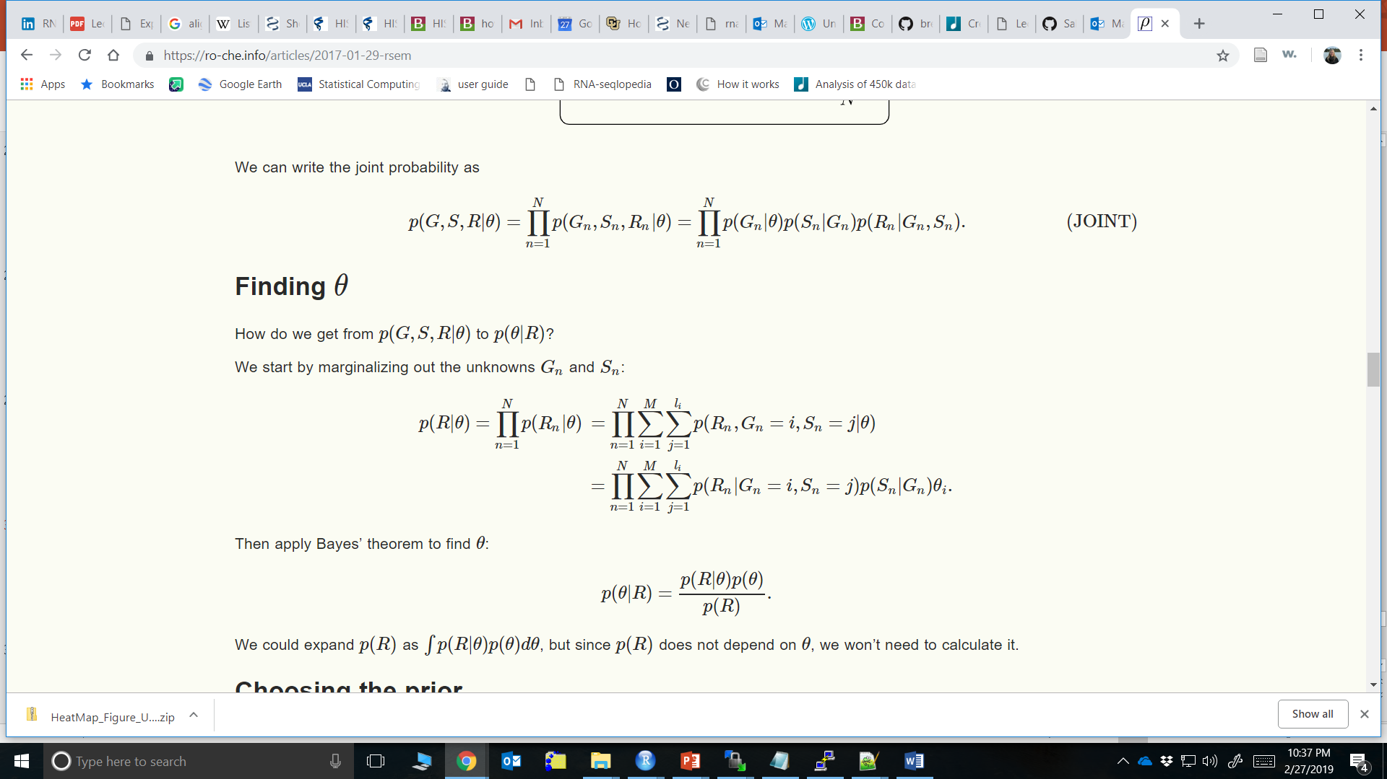
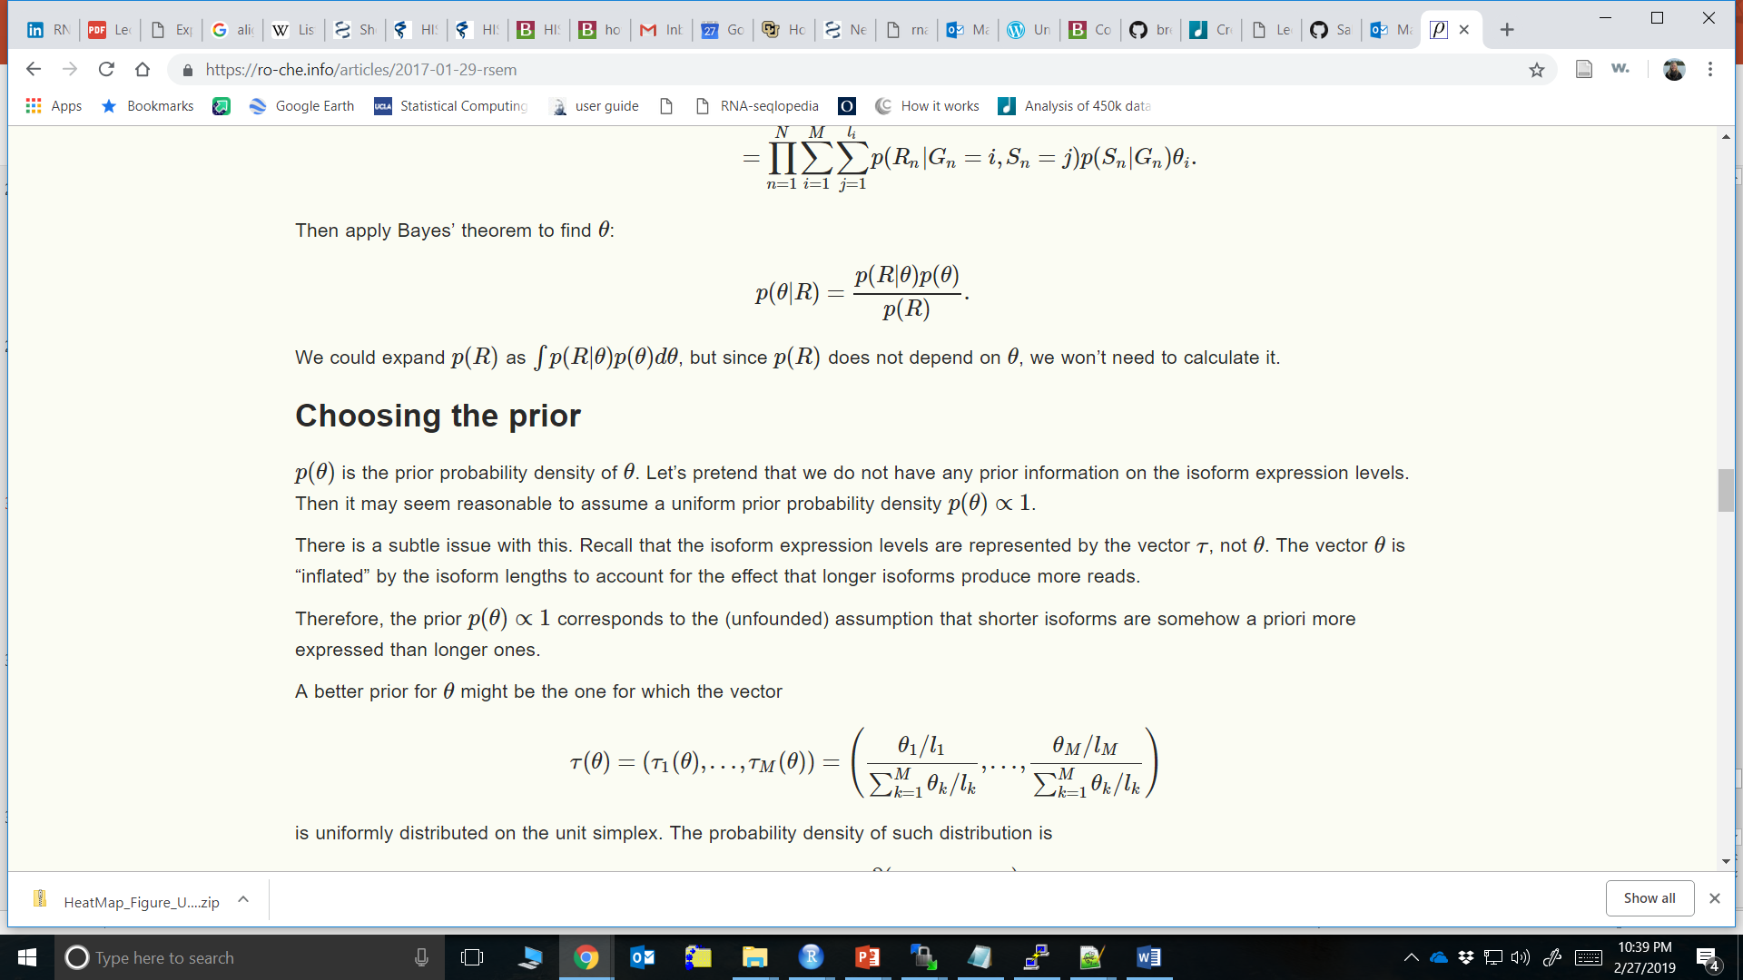
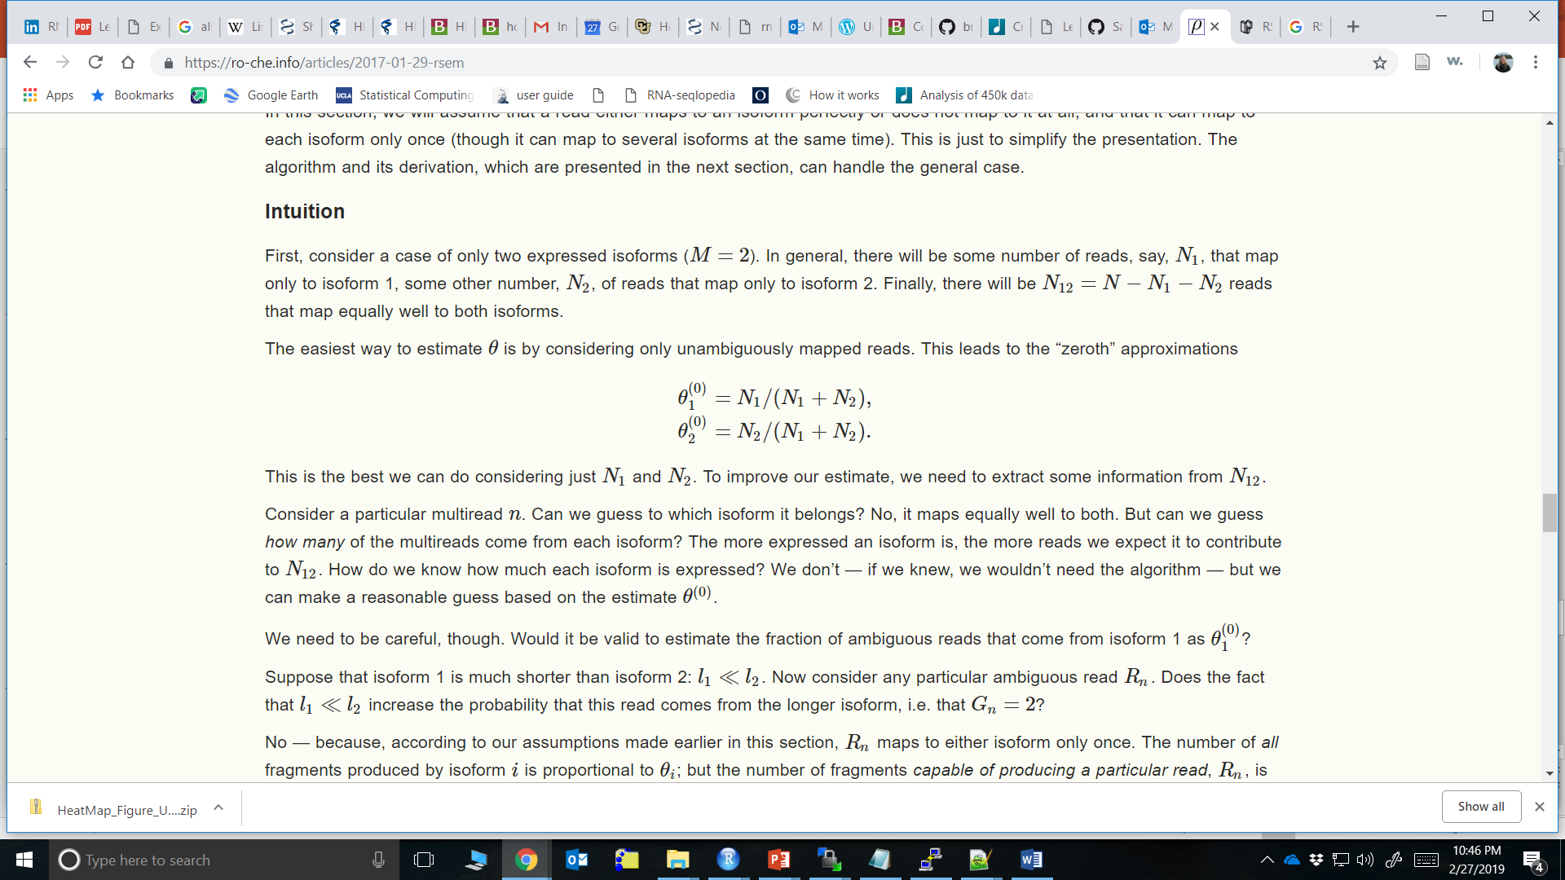
RSEM Quantitation 4
Start with a joint probability:
With lots of math:
Start an estimate of ϴ1 and ϴ2 (assuming a simple 2 isoform dataset with N1 # reads aligning uniquely to isoform 1 and N2 # reads aligning uniquely to isoform 2

Slide 32
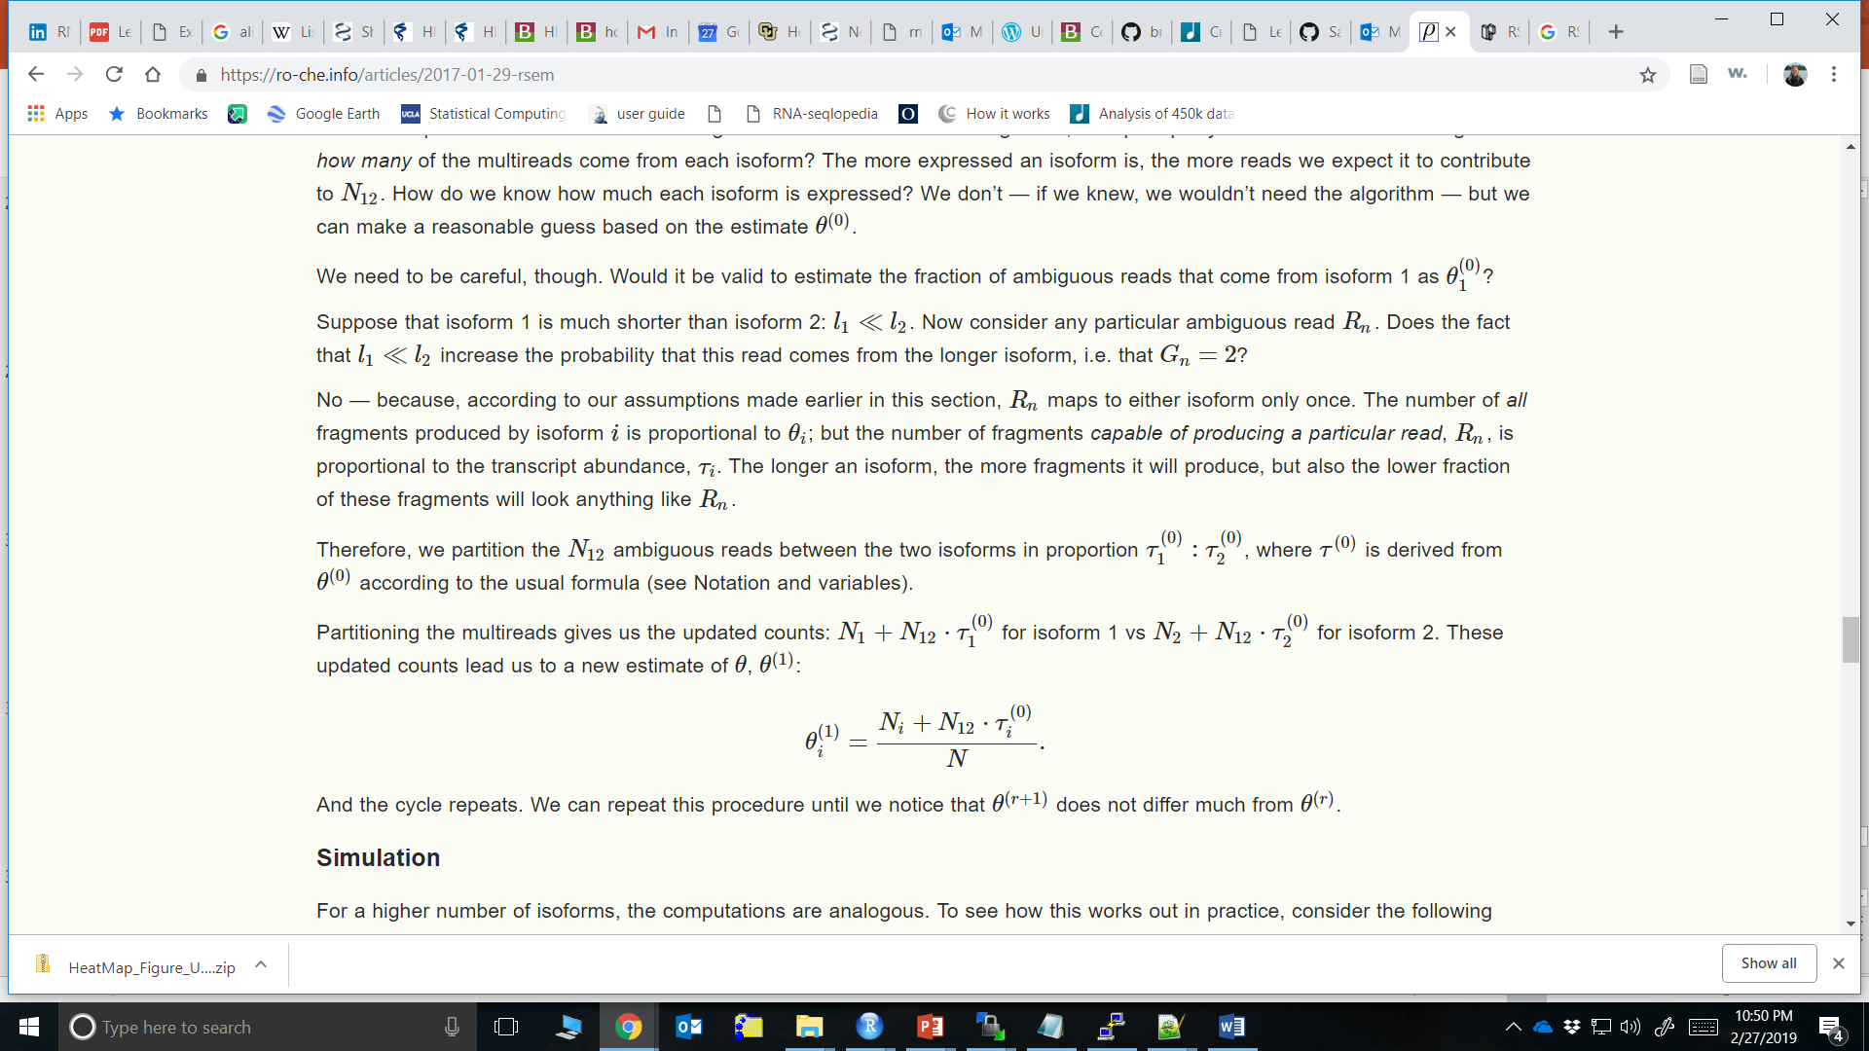
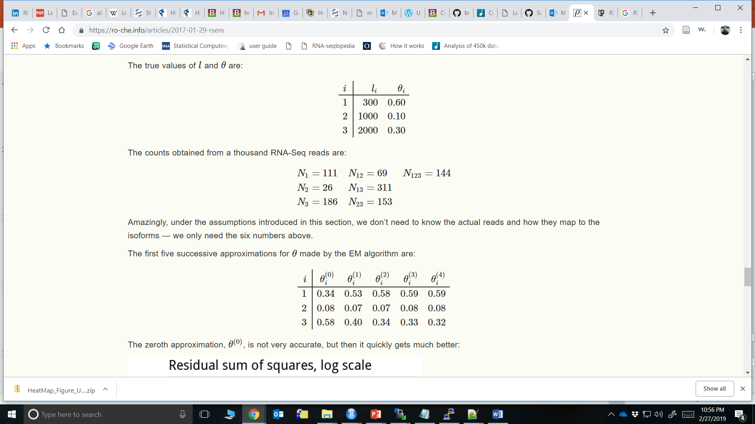

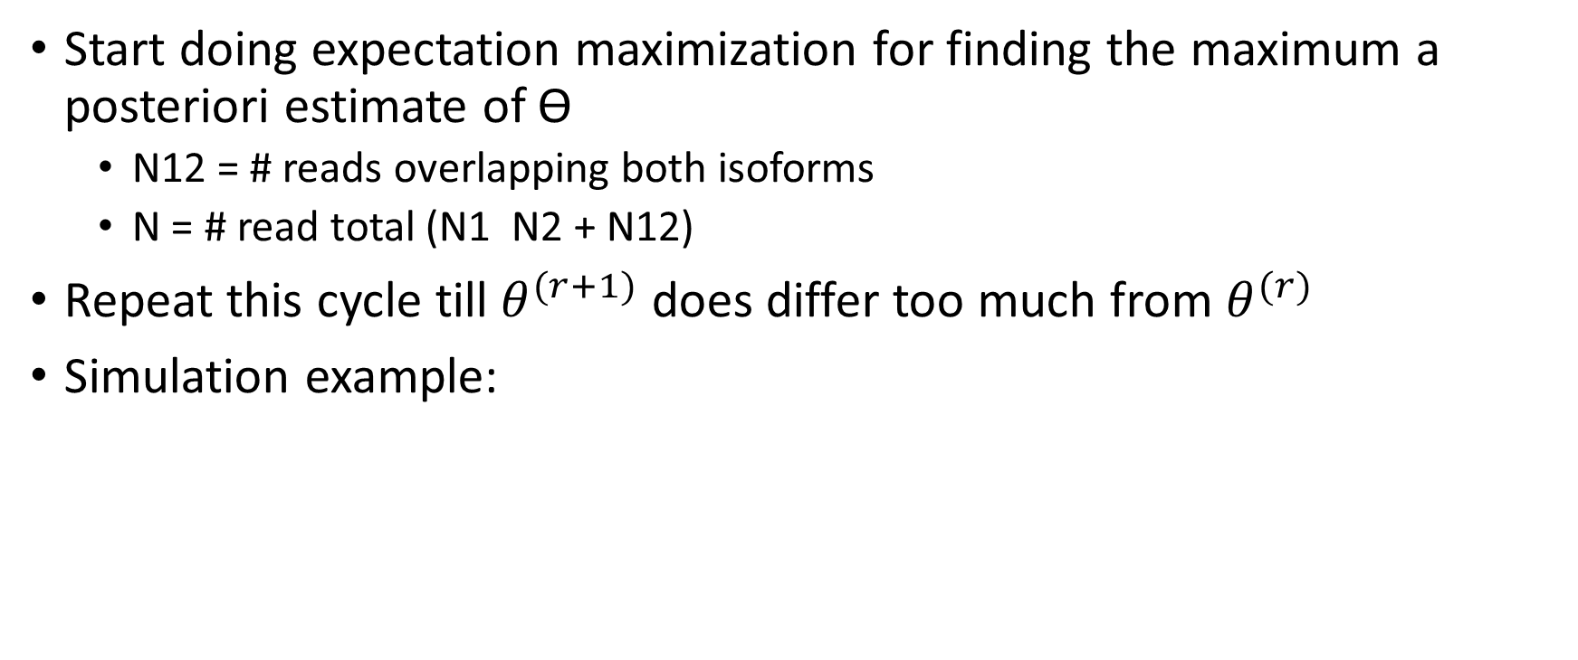
RSEM Quantitation 5
Start doing expectation maximization for finding the maximum a posteriori estimate of ϴ
N12 = # reads overlapping both isoforms
N = # read total (N1 N2 + N12)
Repeat this cycle till $θ^{(r+1)}$ does differ too much from $θ^{(r)}$
Simulation example:
Truth Counts RSEM iterations

Slide 33
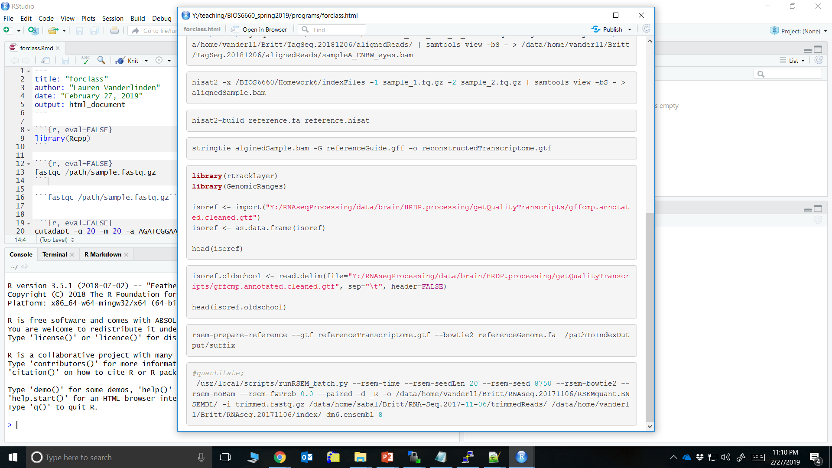
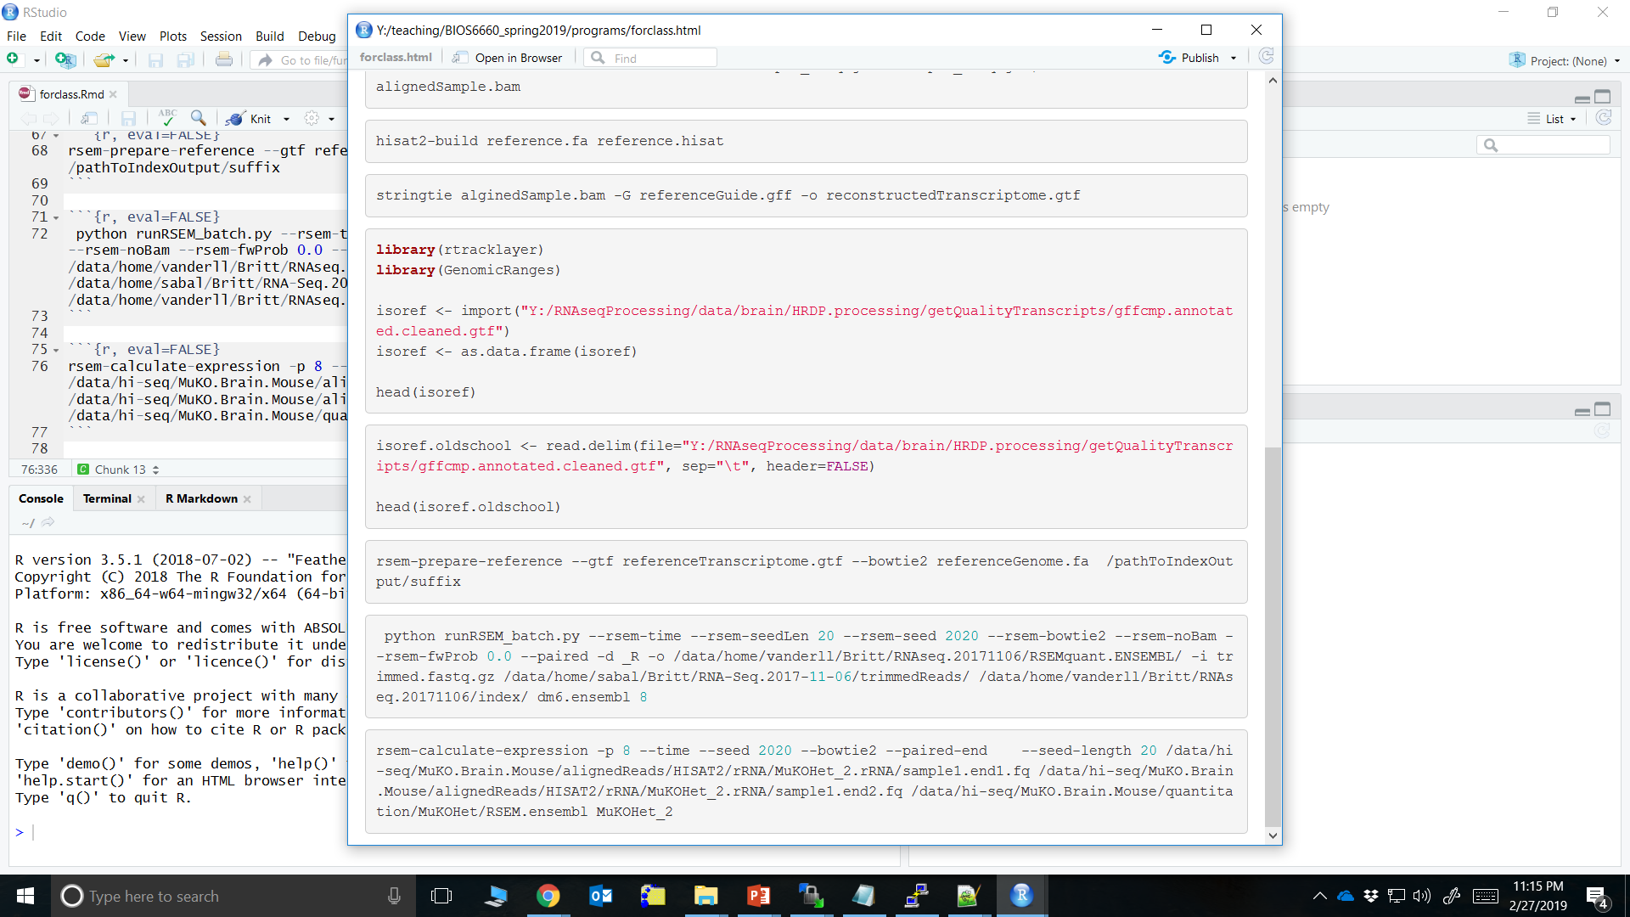
RSEM Code
Like alignment tools, you need to build a reference
It is actually aligning to the transcriptome within this process (bowtie)
RSEM on sample:

Slide 34
RSEM Batch
Python script called: runRSEM_batch.py
Written by Spencer Mahaffey (thank you again!)

Slide 35

RSEM Output
Folder with sample name:
3 files regarding mathematical files
1 files for count estimated at each iteration
1 file for other mathematical estimates in model
4 Files per sample:
sampleName.genes.results
sampleName.isoforms.results
sampleName.rsem.out
sampleName.time

Slide 36

RSEM Output 2
The genes.results and isoforms.results files have the same format

Slide 37

RSEM Merge Data

Slide 38
Reporting Preprocessing
Data
When downloaded
Where saved
Processing code
Just referencing where or what was run
Versions of programs
Summary of reads at each step
If quantitating to a known reference transcriptome, like to check out percentage Ensembl “biotype” aligned to
Look at Rmarkdown report
The Rmd and html will be available on yampa under:

Slide 39
References
Hansen KD, Brenner SE, Dudoit S (2010). Biases in Illumina transcriptome sequencing caused by random hexamer priming. Nucleic Acids Res. 38(12):e131.
Pertea M, Pertea GM, Antonescu CM, Chang TC, Mendell JT, Salzberg SL. (2015) StringTie enables improved reconstruction of a transcriptome from RNA-seq reads. Nat Biotechnol. 33(3):290-5.
Martin JA, Wang Z. (2011) Next-generation transcriptome assembly. Nat Rev Genet. 12(10):671-82.
Cole Trapnell, Adam Roberts, Loyal Goff, Geo Pertea, Daehwan Kim, David R Kelley, Harold Pimentel, Steven L Salzberg, John L Rinn, and Lior Pachter (2012) Differential gene and transcript expression analysis of RNA-seq experiments with TopHat and Cufflinks. Nat Protoc. 2012 Mar 1; 7(3): 562–578.
Li, B., Ruotti, V., Stewart, R.M., Thomson, J.A. & Dewey, C.N. (2010). RNA-Seq gene expression estimation with read mapping uncertainty. Bioinformatics 26, 493–500.
https://www.biostat.wisc.edu/bmi776/lectures/rnaseq.pdf

